Slide 1
RC5
VC 210 Recitation Class
Linda Wei
SJTU

Slide 2
6.Theromodynamic

Slide 3
Laws of Theromodynamic
First law: U=q(heat energy gets into the system)+w(work done to the system)
Key words in problems:
1、Isolated system: ΔU=0, the internal energy didn’t change
2、Const volume: gas does not expand, work=0;

Slide 4
Reaction system
Open system: The matter and energy will continuously exchange with outside. Eg. An open bottle
Closed system: The energy will exchange with outside. Eg. A closed ball
Isolated systm: Neither does the energy and the matter will exchange with outside.

Slide 5
Work
The work that we will mainly discuss is the expansion work, which has the formula that: w=-P_{ex}*Δv,P_{ex} is the pressure of the outer place.
When the temperature is a constant
dw=-P_{ex}dV=-P_{ex}*V/V*dV=-nRT*dv
We integrate both side of the equation and we get:
W=-nRT*ln(v_{final}/v_{initial})

Slide 6
Heat Capacity
Definition: c=q/ΔT, the unit of heat capacity is J/K
Specific heat capacity: c_{s} = c/m.
Molar heat capacity: c_{m} = c/n

Slide 7
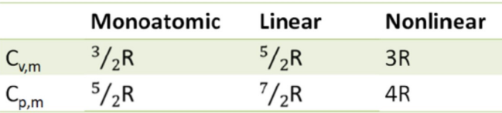

C_{v} and C_{p}
Why?
Cv,m=$\frac{iR}{2}$
i=Degree of Freedom
Monoatomic;i=3,3 stationary degree of freedom.
Lienar i=3 stationary dof +2 rotating dof
Nonlinear i=3+3……

Slide 8
Enthalpy
H = U + P*V
ΔH=H₁-H_{2，}
When the pressure is a constant: ΔH=Q;
Enthalpy change is the reaction heat at constant pressure without conversion of electric energy, light energy and other energy with the outside world.

Slide 9
Key words
For chemical reaction open to atmosphere or constant pressure:
Exothermic: ∆H < 0.
Endothermic: ∆H > 0.

Slide 10
Change of state
Vaporization:
∆H_{vap} = H(vapor) − H(liquid)
Fusion:
∆H_{fus} = H(liquid) − H(solid)
Sublimation:
∆H_{sub} = H(vapor) − H(solid)

Slide 11
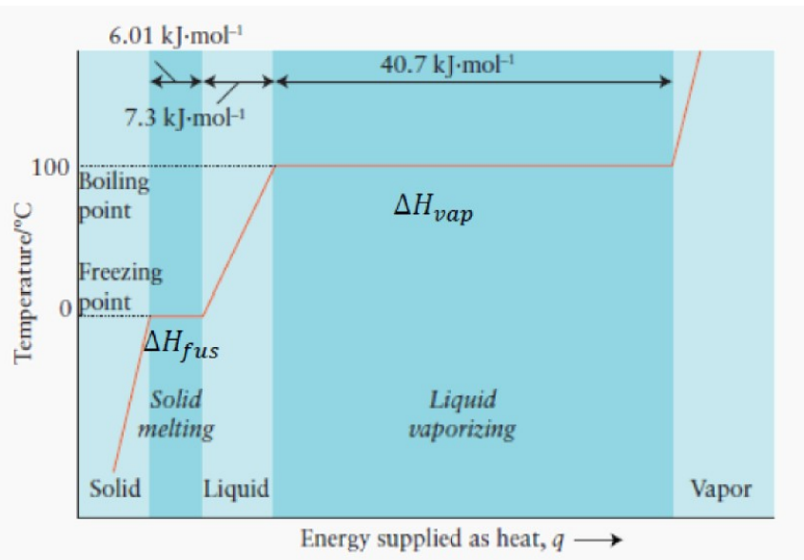
Heating Curve

Slide 12
Standard Enthalpy
Standard State(pay attention, not S.T.P)
Pressure: 1 bar
Temperature: 298.15 K (not 273.15 K or 0℃)
Solution concentration (if solution is involved): 1 mol/L
Denote as X◦
Standard mole enthalpy of formation(标准摩尔生成焓）

Slide 13
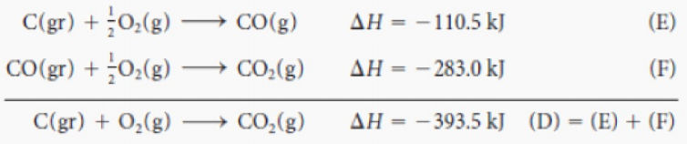
Hess Law
The reaction heat of chemical reaction is only related to the initial and final states of the reaction system, but has nothing to do with the reaction pathway.

Slide 14
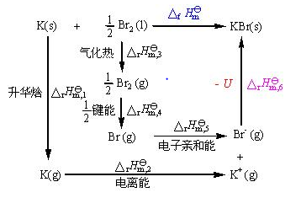
Born-Haber Cycle
We use this to calculate the lattice energy.

Slide 15
Entropy
Spontaneous change: change that can occur without external influences.
Entropy (S): measure of disorder. Disorder ↑, entropy ↑.
The second law of thermodynamics: The entropy of an isolated
system increases in the course of any spontaneous change.

Slide 16

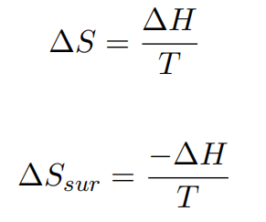
Entropy Change
Reversible process: For a change: state 1 to state 2, if we can find some ways to get state 2 back to state 1, the change is a reversible process.

Slide 17
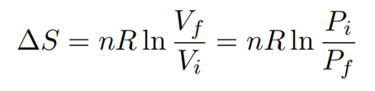
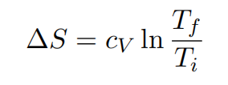
Ideal Gas-Reversible Process
Constant temperature & reversible process & ideal gases:
Constant volume & constant c & reverse process & ideal gases:

Slide 18

Trouton’ Rule
Approximately, for any liquid converted to vapor, the entropy change:

Slide 19
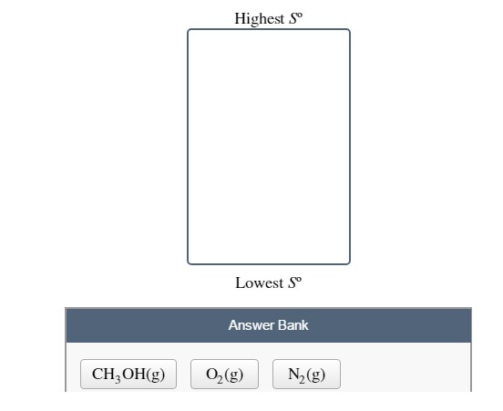
Compare Entropy
1、Gas>Liquid>Solid
2、Complex molecule has higher Entropy
3、Heavier molecule has lager energy
4、Polar molecular has less Entropy.

Slide 20

Standard Entropy

Slide 21
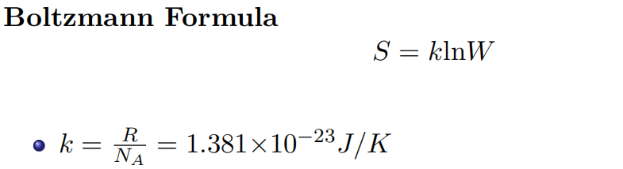
Third law of thermodynamic
Residual entropy:
W: microstates, the number of possible positions that
atoms/molecules can be arranged.
S: absolute entropy at any temperature, called ”residual
entropy”.

Slide 22
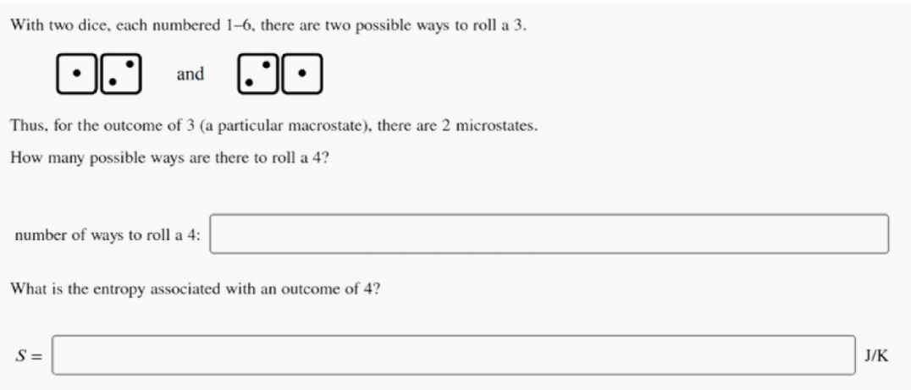
Example

Slide 23
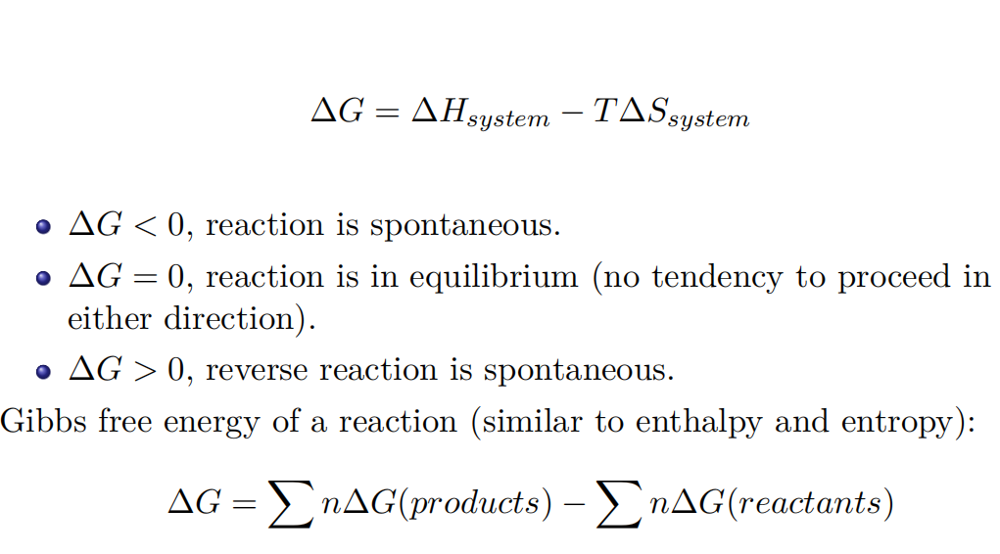
Gibbs Free Energy
Maximum Non-Expansion work
W=-ΔG

Slide 24
Reference
[1] CHEMICAL PRINCIPLES-THE QUEST FOR INSIGHT
(Seventh Edition)
[2] Wei Xiwen, RC2, VC210 FA2020
[3] Inorganic Chemistry 4th Edition

Slide 25
Thank you~

